Slide 1
Operation Management and SCM

Slide 2
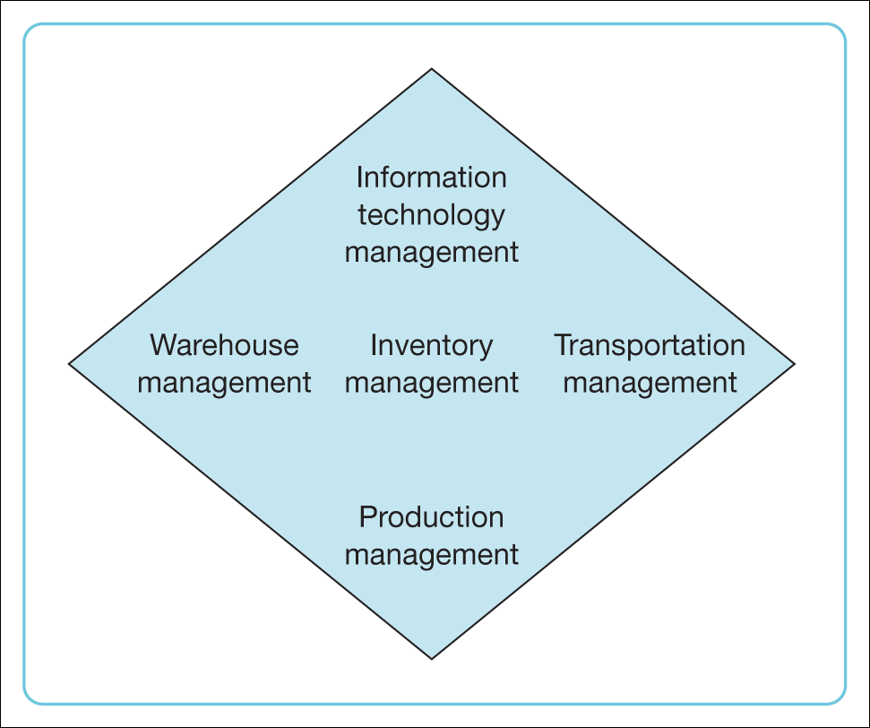

Slide 3
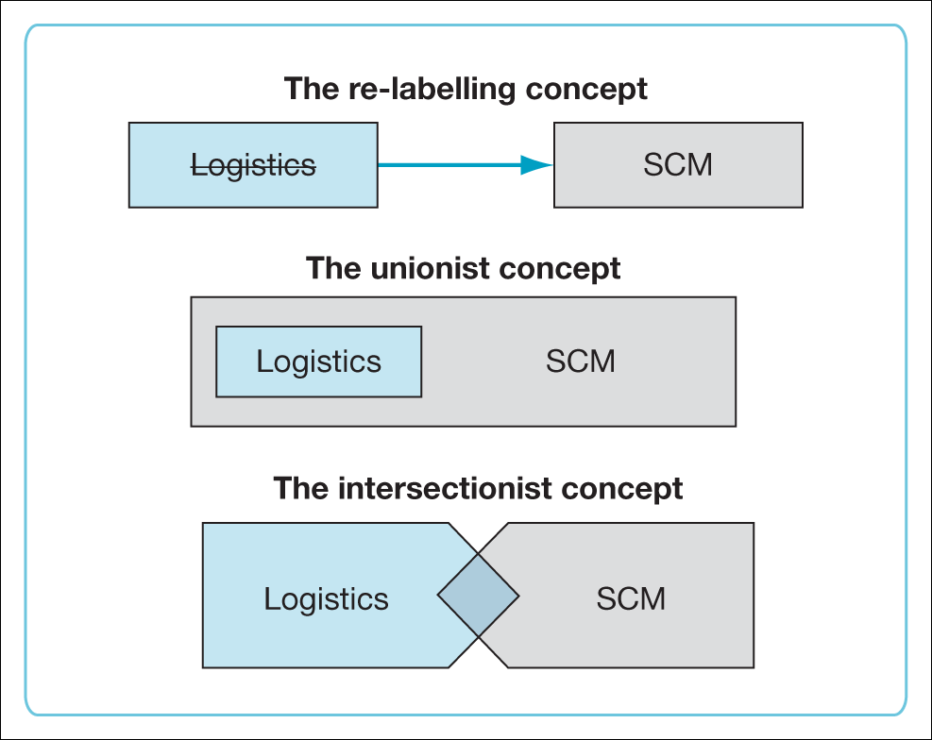
Figure 1.2 Logistics versus supply chain management Source: adapted from Larson and Halldórsson (2004).

Slide 4
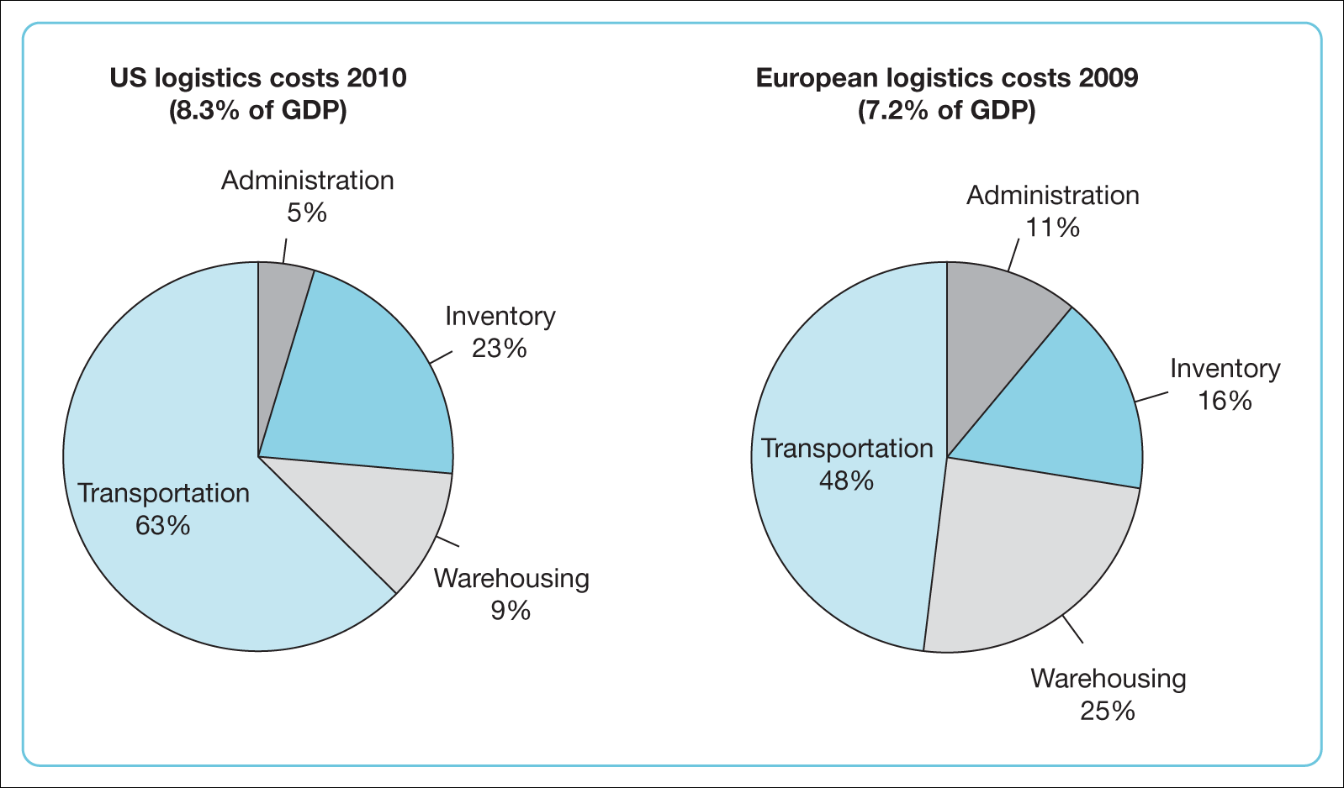
Figure 1.4 Logistics costs by activity Source: Wilson (2011).

Slide 5
Supply Chain Management
Supply Chain Management is primarily concerned with the efficient integration of suppliers, factories, warehouses and stores.

Slide 6
Supply Chain Management
The products is produced and distributed in the right quantities, to the right locations and at the right time, and so as to minimize total system cost subject to satisfying service requirements.

Slide 7
The supply chain encompasses all of activities associated with moving goods from the raw-materials stage through to the end user.

Slide 8
Supply Chain Management can be defined as the management of flow of products and services, which begins from the origin of products and ends at the product’s consumption.

Slide 9
SCM activities
Inbound and outbound transportation,
Warehousing, and inventory control.
Sourcing, procurement, and supply management
Forecasting, production planning and scheduling,

Slide 10
History of Supply Chain Management
1960’s - Inventory Management Focus, Cost Control
1970’s – Materials Management, Operations Planning
1980’s - Materials Management, Logistics
1990’s - Enterprise resource planning, Purchasing, Financials, Manufacturing, Order Entry
2000’s - Optimized “Value Network” with Real-Time Decision Support; Synchronized & Collaborative Extended Network

Slide 11
SCM Processes
There are three different types of flow in supply chain management:
Material flow
Information/ Data flow
Money flow

Slide 12
What’s new in SCM?
Global competition
Shorter product life cycle
New, low-cost distribution channels
More powerful well-informed customers
Internet and E-Business strategies

Slide 13
New Concepts
Push Pull strategies
Direct-to-Consumer
Dynamic Pricing
E-Procurement

Slide 14
DECISION PHASES
Successful supply chain management requires many decisions relating to the flow of information, product, and funds
1. Supply Chain Strategy or Design
2. Supply Chain Planning
3. Supply Chain Operation

Slide 15
PROCESS VIEWS OF A SUPPLY CHAIN
1. Cycle View: The processes in a supply chain are divided into a series of cycles
2. Push/Pull View: The processes in a supply chain are divided into two categories depending on whether they are executed in response to a customer order or in anticipation of customer orders.
Pull processes are initiated by a customer order
Push processes are initiated and performed in anticipation of customer orders.

Slide 16
SUPPLY CHAIN MACRO PROCESSES IN A FIRM
1. Customer Relationship Management (CRM)
2. Internal supply chain management (ISCM)
3. Supplier Relationship Management (SRM)

Slide 17
ACHIEVING STRATEGIC FIT AND SCOPE
Product development strategy specifies the portfolio of new products that a company will try to develop. It also dictates whether the development effort will be made internally or outsourced

Slide 18
ACHIEVING STRATEGIC FIT AND SCOPE
All processes and functions that are part of a company's value chain contribute to its success or failure.
These processes and functions do not operate in isolation; no one process or function can ensure the chain's success.
Failure at any one process or function, however, may lead to failure of the overall chain.

